Slide 1


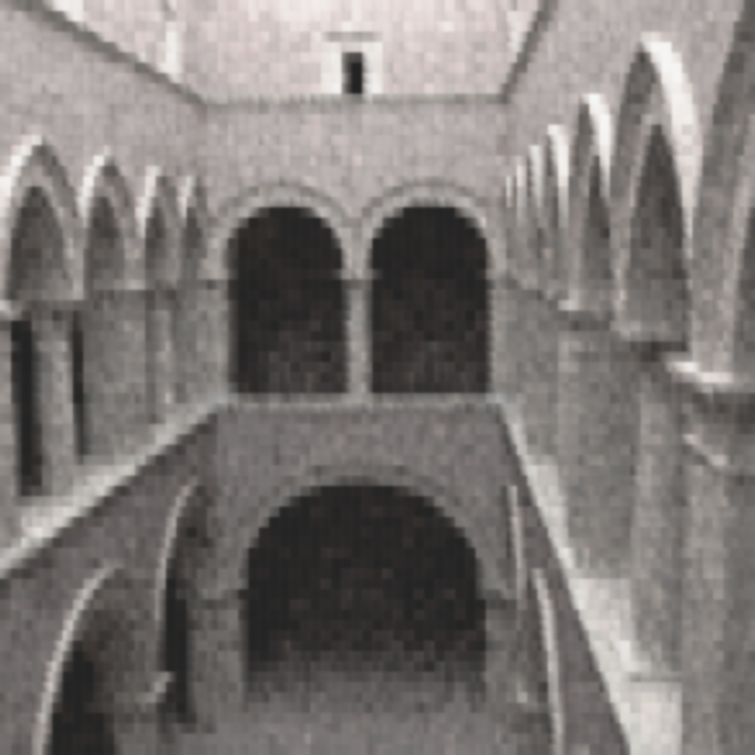
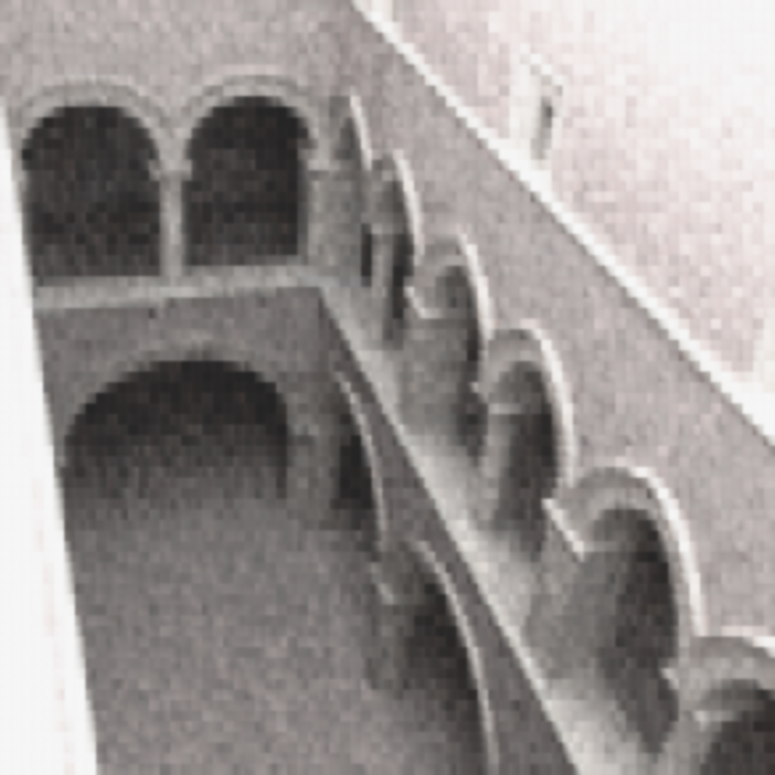
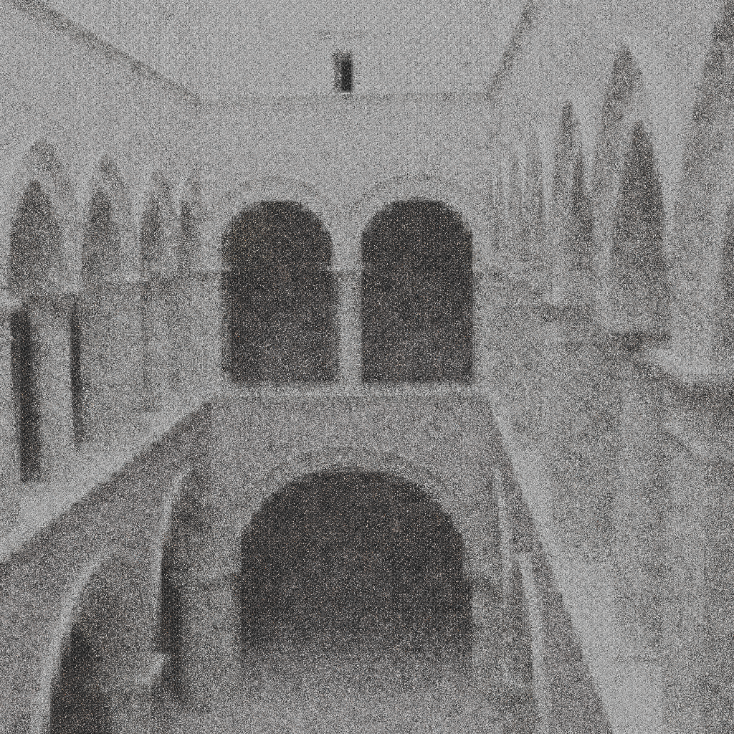
Investigating Machine Learning to remove Monte-Carlo noise in rendered images
Andrea Luongo, Alessandro Dal Corso
Introduction
Problem statement
Related vork and references
Our work
Why it is important (we have reference images so we can do supervised learning)
Method
We based our neural network implementation on the work by [Vincent08,10] on denoising autoencoder.
The network consists of two parts. First, we use a pretraining network composed of a series of denoising autoencoders to initialize the parameters of our network. Then, we add an extra hidden layer and we update the parameters by performing finetuning.
We performed supervised learning using a dataset containing patches taken from rendered images with different levels of Monte Carlo noise.
Results
We implemented our neural network using theano framework running on a NVIDIA GTX 780 Ti GPU. As training dataset we used all the 16x16 patches taken from three rendered 1024x1024 views of the Sponza scene. Renderings were generated using a path tracer implemented in the OptiX ray-tracing engine. We used a diffuse material with (1,1,1) reflectance for all surfaces, plus a constant environment illumination.
Validation was performed on another view of the same scene.
Conclusions and Future work
Promising approach
Need more investigation and validation on the hyperparameters
CNN
Investigatring approach from otrher paper
Materails
References
Noise in montecarlo images
Survey on denoising techniques in Monte Carlo Rave, Jensen
Da vincent 08
Sda vincent 10
Deep learning for image denoising
SIGGRAPH 2015 ML for image denoising in monte carlo
Note eller Institutnavn (Arial Regular 18/24pt.)
Note eller Institutnavn (Arial Regular 18/24pt.)
Notes:
Tekst og Streger i 100% farve – Baggrund i 90% Transparent.

